Slide 1
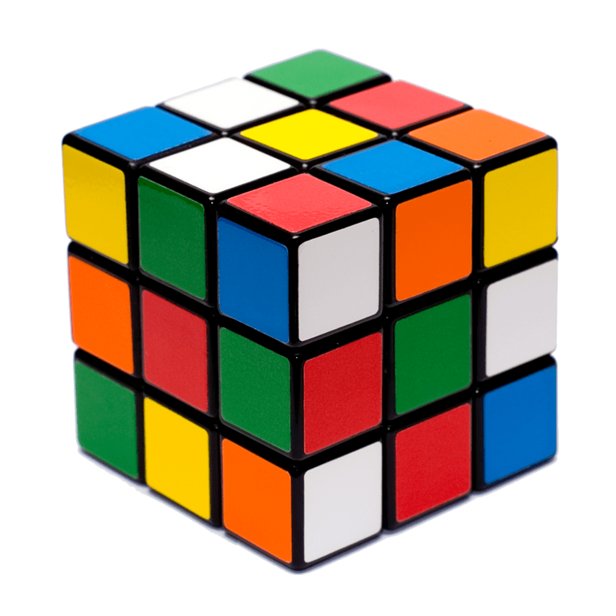
Topic: Index Notation
EQ: What are cubed numbers and how does this link to index notation?

Slide 2
Task One
On your tables, as a group, complete the cubed numbers investigation.
Calculate the number of smaller cubes in each larger cube.

Slide 3
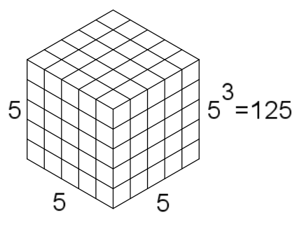
24
7
30
Date
Index notation
EQ – What are cubed numbers and how does this link to index notation?
How do I cube a number?
First, make a square. Both side have the same length.
Th Then make a cube where all
three sides are the same length.
9

Slide 4
Task Two
Each of you has been given a card.
Decide if your number is a square number or a cubed number. Evaluate your number.
Give one / Get one - Share answers with peers.
Swap cards.
Go again.

Slide 5
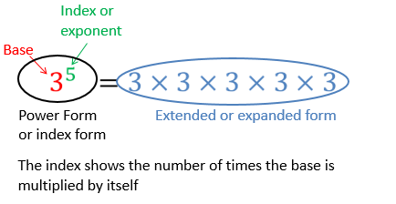
24
7
30
Date
Index notation
EQ – What are cubed numbers and how does this link to index notation?
What is index notation?
9

Slide 6
Sentence Frame
Summary:
Square numbers __________________________.
Cubed numbers can be found by __________ a number by ________ and then by ________ again. E.g. 5³ = __ x __ x __ = _____
Index notation tells us _____________________.

Slide 7
Homework
Review your notes and write a summary answering the essential question.

